Slide 1
Assignment 2
Step by Step Development (outline)
The code below is designed to be easy to explain. Upgrade the code to improve your programming skills.
You should read 04-23-2020 Assignment2 Discussion 1.pptx before starting this slide
April 24, 2020

Slide 2
Preparation
Create a project
Create a package
Download MenuGUI.java from canvas. Add (or import) MenuGUI to your package.
Download burger1.png, burger2.png and burger3,png and save it in the correct location.

Slide 3
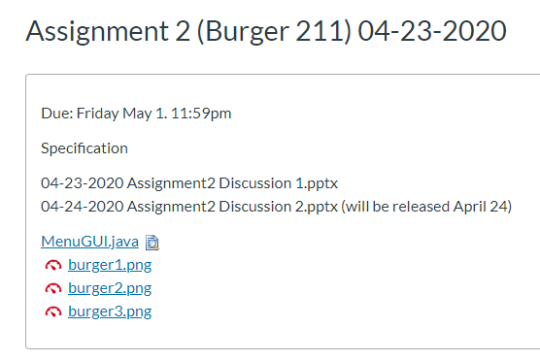
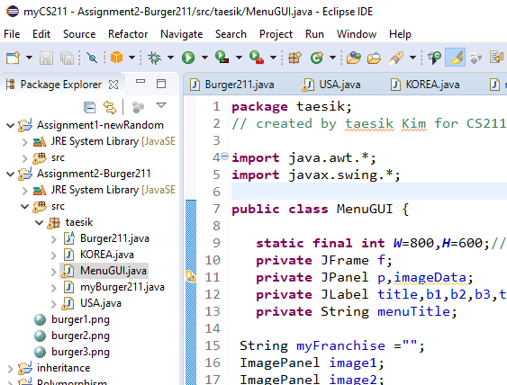
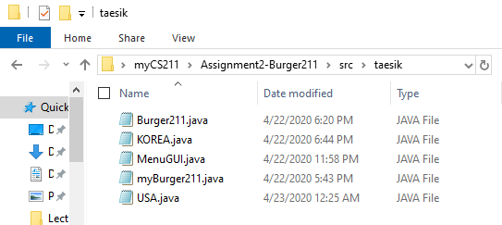
Preparation step 3/4
Download MenuGUI.java from canvas, save it to your package folder. In case of jGrasp, save it to source folder.
workspace
project
Source
folder
package
import MenuGUI to eclipse
If you don’t know how to do this, follow next slide, otherwise jump to slide #11.

Slide 4
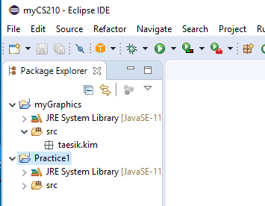
FYI
From my cs210 lecture note
How to add(import) .java file into your project
Assume that you have a project (myGraphics) and a package (taesik.kim)

Slide 5
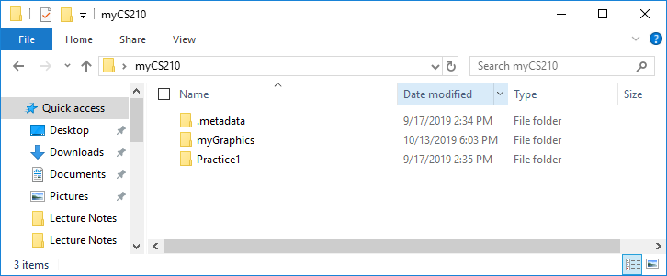
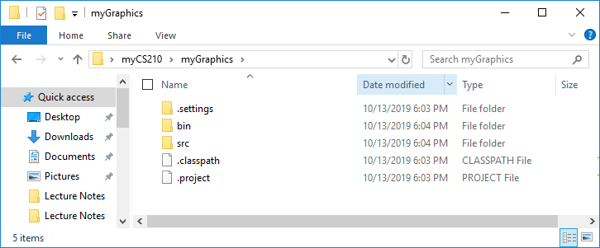
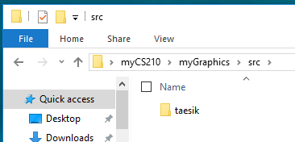
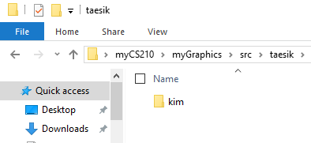
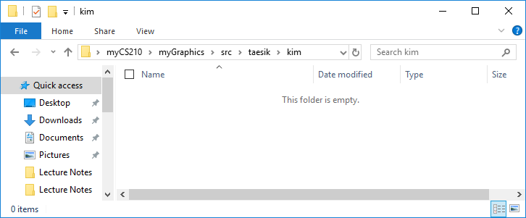
your work space
From my cs210 lecture note
your project name
your package name
your package name
place a .java file here

Slide 6
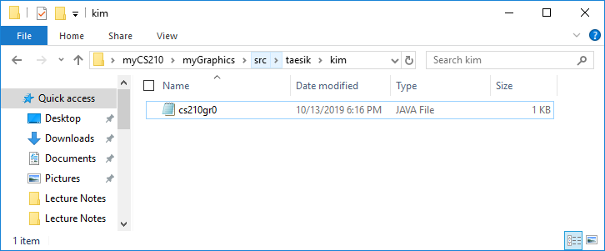
From my cs210 lecture note
.java file you want to add to your project.

Slide 7
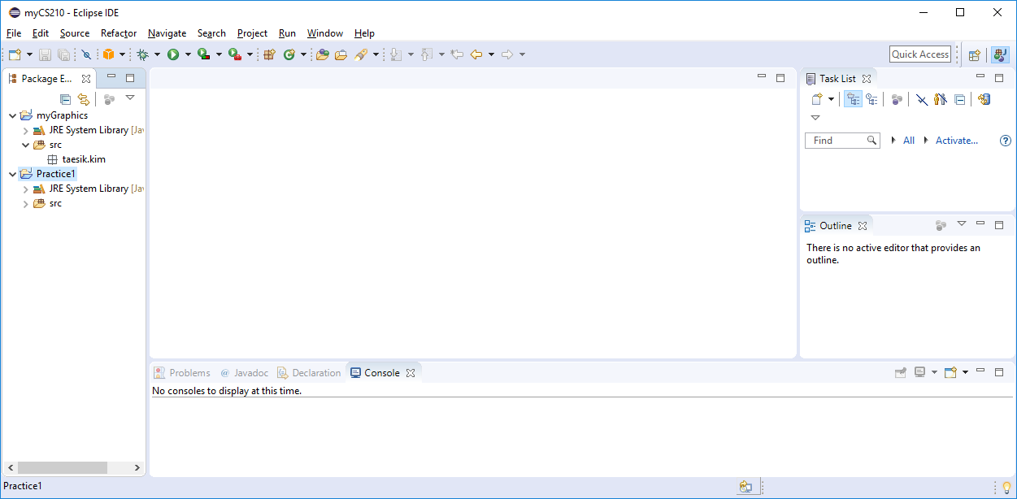
From my cs210 lecture note
Open eclipse

Slide 8
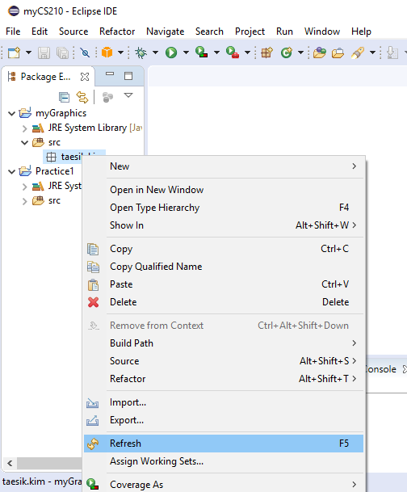
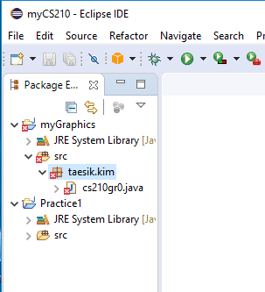
From my cs210 lecture note
1
Right click your package
The file is now loaded but error.
2
Hit Refresh
Click to open this file

Slide 9
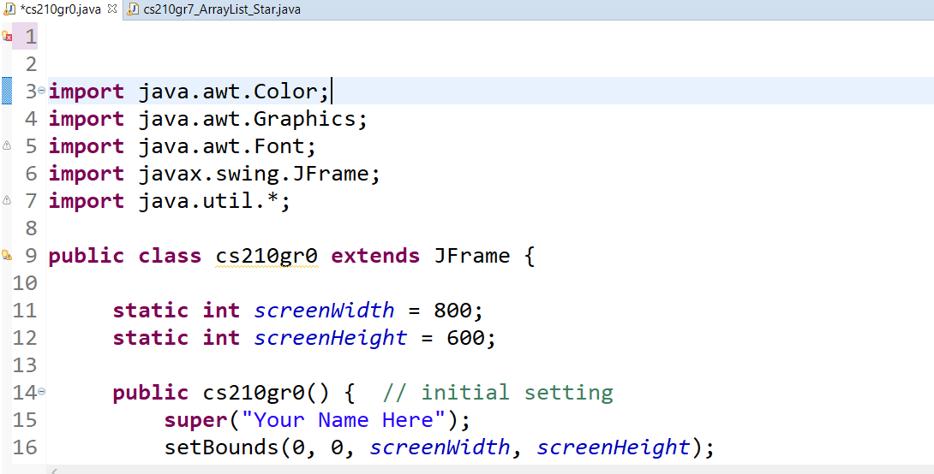
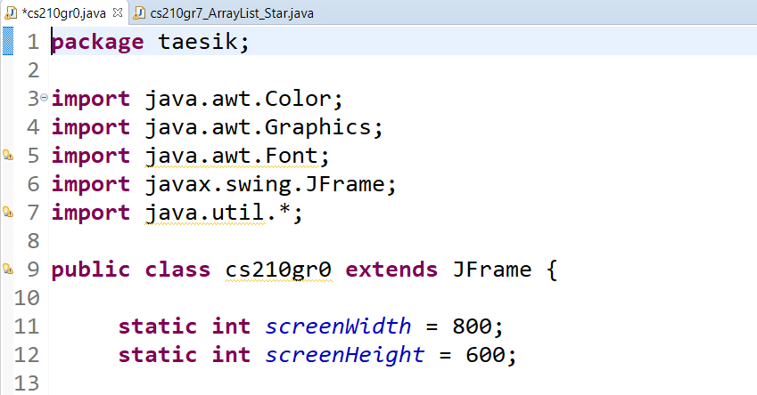
From my cs210 lecture note
The reason why this program issue an error is “THERE IS NO PACKAGE NAME” or “DIFFERENT PACKAGE NAME”
ADD/replace your package name.

Slide 10
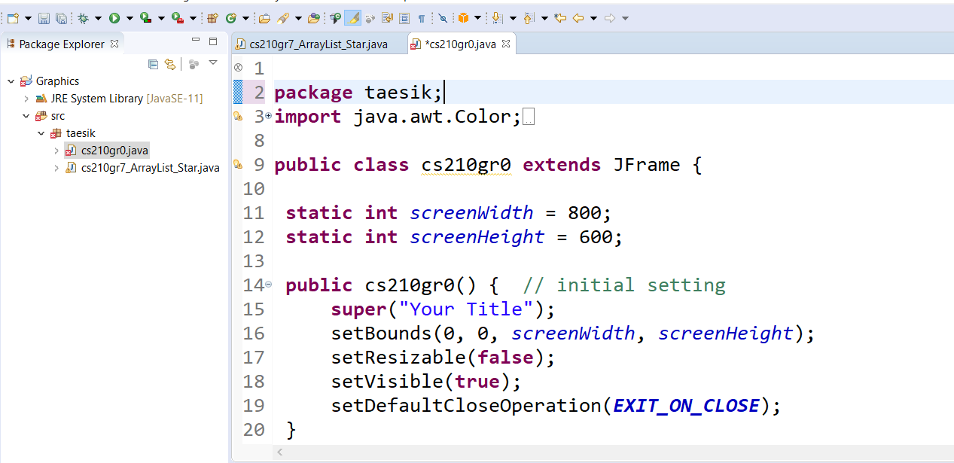
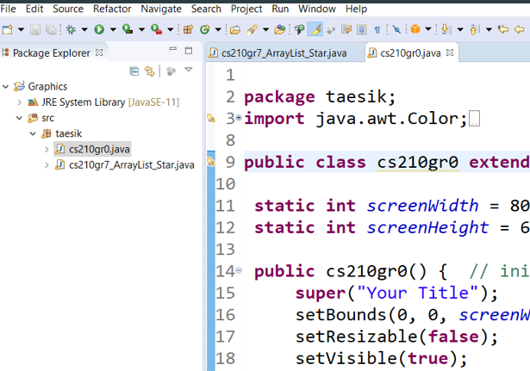
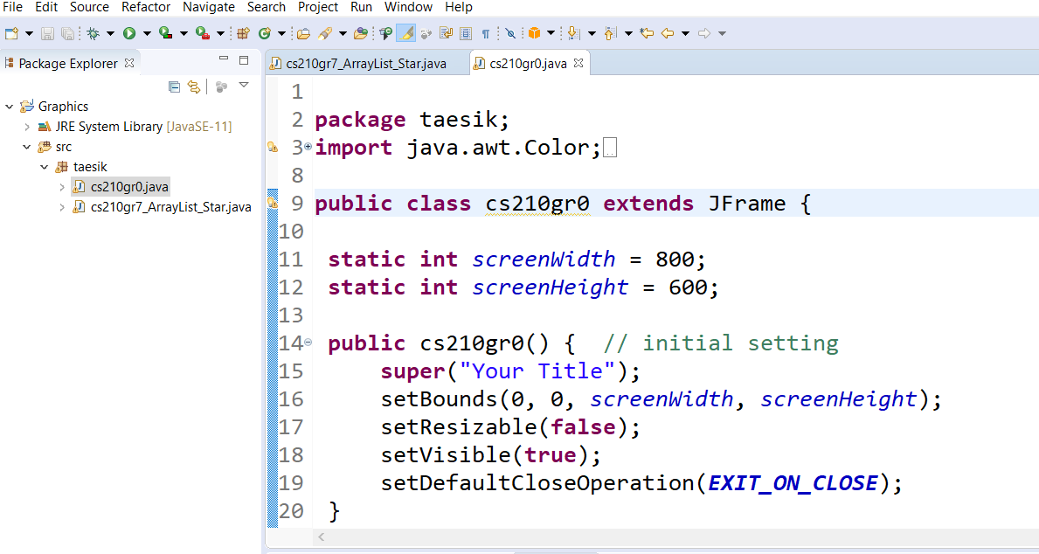
From my cs210 lecture note
Click to save
Error mark disappears after a few seconds.

Slide 11
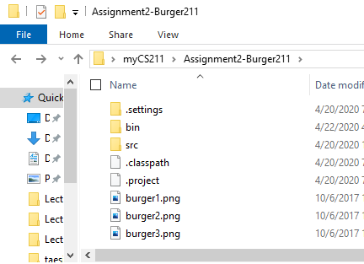
Preparation step 4/4
Download burger1.png, burger2.png and burger3,png and save it in Project folder.
In case of jGrasp, save it to source folder.
workspace
project
Names appear in the eclipse

Slide 12
Development steps

Slide 13
1. Define data
USA
name1="Inheritance Burger"; name2="Overriding Burger"; name3="Polymorphism Burger“ price1=3.0; price2=2.0; price3=3.5; topping1="beef patty, tomato, onion, ranch source"; topping2="beef patty, lime, onion, lettuce, tomato source"; topping3="chicken breast, gallo, onion, ranch source"; Promotion=“Stay Home 50% off”; MenuStyle=“English, $”;
France
name1="Inheritance Burger"; name2="Overriding Burger"; name3="Polymorphism Burger“ price1=3.0 * exchange rate ; price2=2.0 * exchange rate ; price3=3.5 * exchange rate ; topping1="beef patty, tomato, onion, ranch source"; topping2="beef patty, lime, onion, lettuce, tomato source"; topping3="chicken breast, gallo, onion, ranch source"; Promotion=“none”; MenuStyle=“French, €;
Korea
name1="Inheritance Burger"; name2="Overriding Burger"; name3="Polymorphism Burger“ price1=3.0 * exchange rate ; price2=2.0 * exchange rate ; price3=3.5 * exchange rate ; topping1="beef patty, tomato, onion, ranch source"; topping2="beef patty, lime, onion, lettuce, tomato source"; topping3="chicken breast, gallo, onion, ranch source"; Promotion=“Winter Olympic 50% off”; MenuStyle=“Korean, W”;

Slide 14
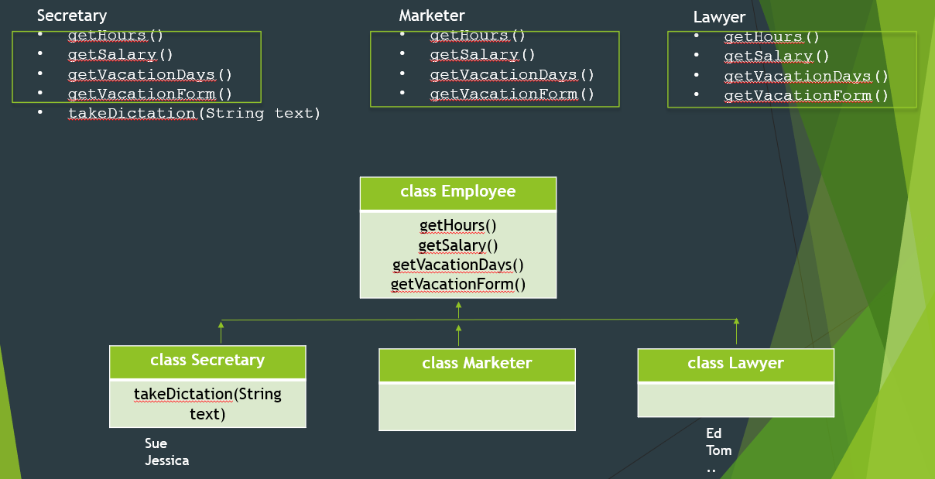
1. create a structure (super and sub class)
Burger211
name1="Inheritance Burger"; name2="Overriding Burger"; name3="Polymorphism Burger“ price1=3.0; price2=2.0; price3=3.5; topping1="beef patty, tomato, onion, ranch source"; topping2="beef patty, lime, onion, lettuce, tomato source"; topping3="chicken breast, gallo, onion, ranch source"; Promotion=“”; Menu{}
USA
@override menu(){ }
France
@override menu(){ }
Korea
@override menu(){ }

Slide 15
2. Data structure in Super class
Burger211
name1="Inheritance Burger"; name2="Overriding Burger"; name3="Polymorphism Burger“ price1=3.0; price2=2.0; price3=3.5; topping1="beef patty, tomato, onion, ranch source"; topping2="beef patty, lime, onion, lettuce, tomato source"; topping3="chicken breast, gallo, onion, ranch source"; Promotion=“”; Menu{}
For practice purposes, let’s define these variables as “private”.
(apply encapsulation)
Let all countries design menu in their own style. So there is no need to implement a menu here. Just define the structure.
(apply abstract class)

Slide 16
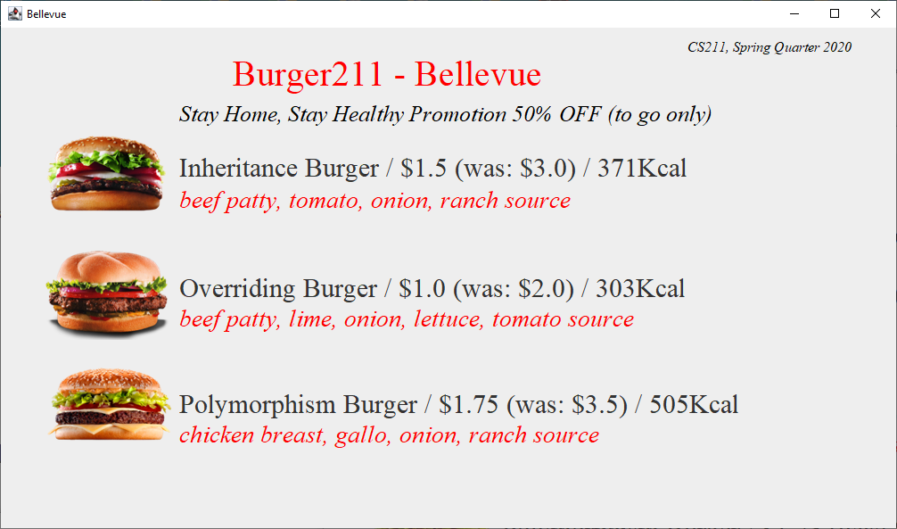
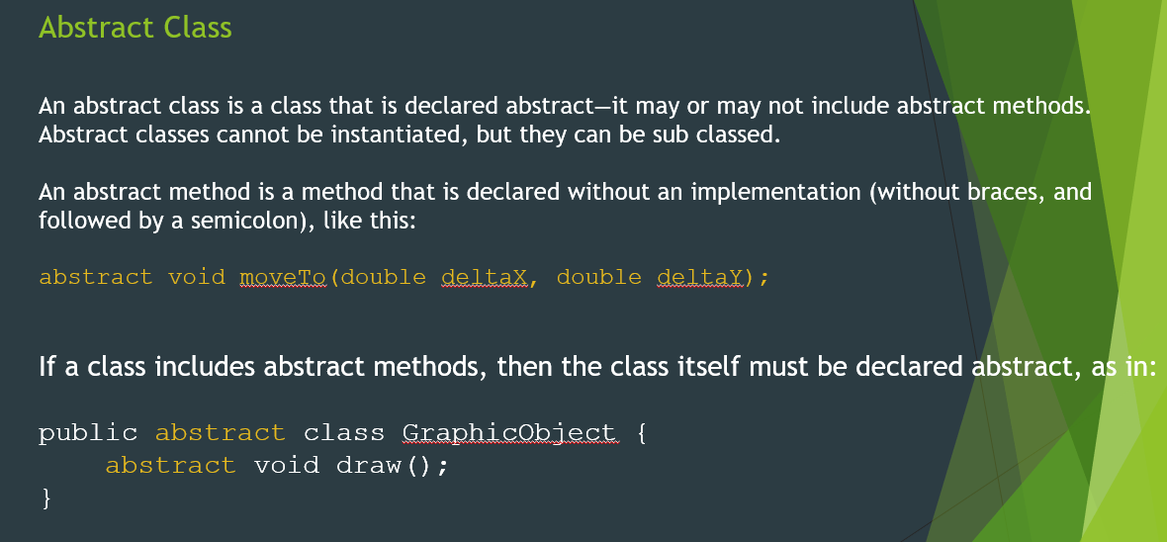
2. Super class - abstract
For printing franchise name
public abstract class Burger211 {
abstract void Menu(String franchise);
}
Slide # 12 (04-22-2020)

Slide 17
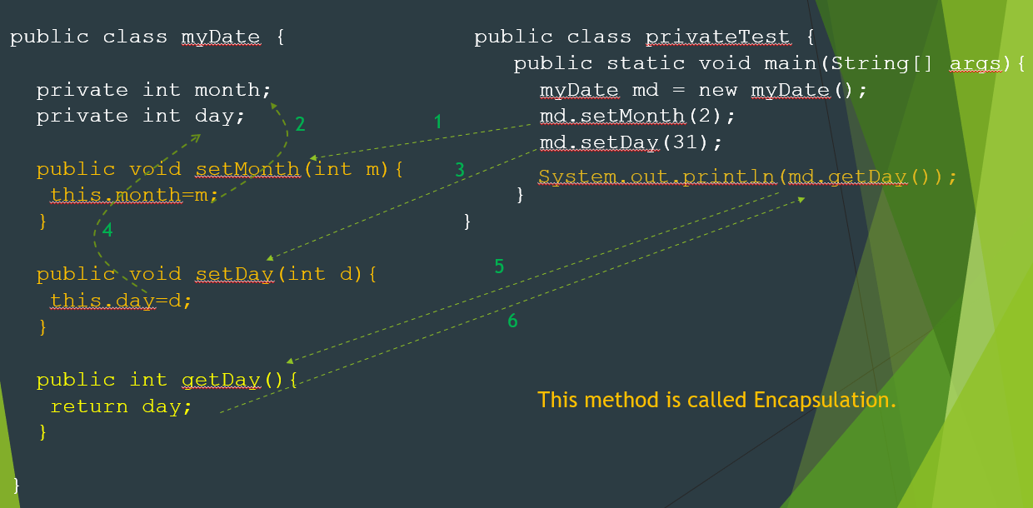
2. Super class - encapsulation
Slide # 10 (04-21-2020)
public abstract class Burger211 {
static private double price1, price2, price3;
abstract void Menu(String franchise);
void price(){
price1=3.0;
price2=2.0;
price3=3.5;
}
public double getPrice1() {
return price1;
}
public double getPrice2() {
return price2;
}
public double getPrice3() {
return price3;
}

Slide 18
2. Super class – Initialization (constructor)
public abstract class Burger211 {
static private double price1, price2, price3;
abstract void Menu(String franchise);
Burger211() {
price();
}
void price(){
price1=3.0;
price2=2.0;
price3=3.5;
}
public double getPrice1() {
return price1;
}
public double getPrice2() {
return price2;
}
public double getPrice3() {
return price3;
}

Slide 19
Sub class KOREA - Structure
package taesik;
import java.text.DecimalFormat;
public class KOREA extends Burger211 {
static double exchangeRate=1000; // foreign currency exchange rate
static double discountRate =0.5; // promotion 0.0~1.0
String info1="", info2="", info3=""; // will be sent to GUI (see slide #23) as parametres.
KOREA(){ // constructor. Super class, Burger211, need to initialize first. Then KOREA will do next.
// You must understand why.
};
}

Slide 20
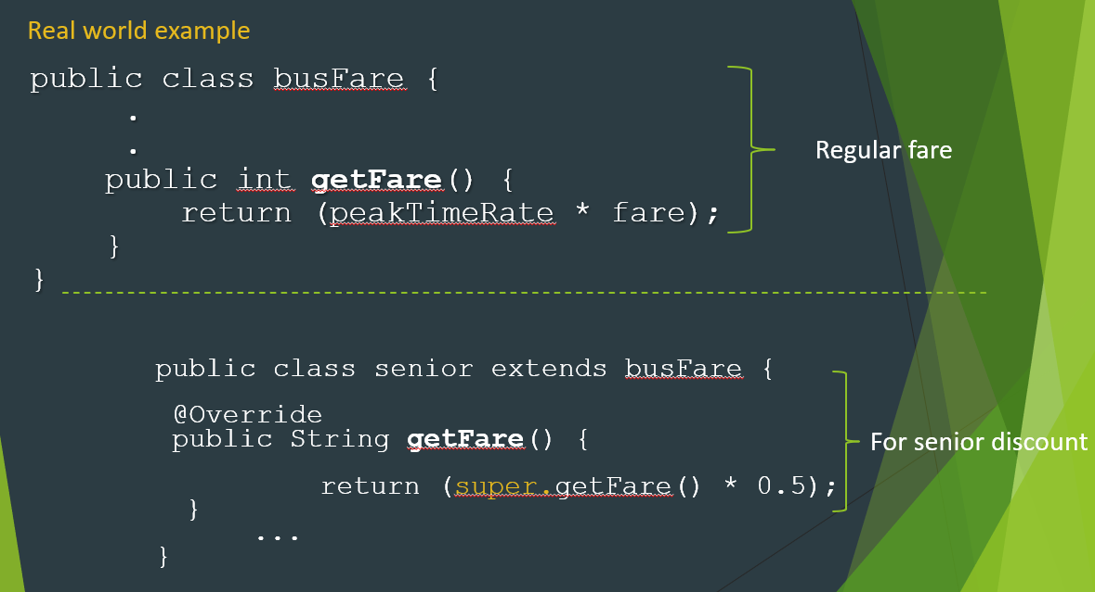
Sub class KOREA – Reading private variable in super class
Slide # 17 (04-16-2020)
@Override
public double getPrice1() {
return (super.getPrice1()*exchangeRate);
}
@Override
public double getPrice2() {
return (super.getPrice2()*exchangeRate);
}
public double getPrice3() {
return (super.getPrice3()*exchangeRate);
}
@Override
public String getAdvertising() {
return "^ Buy One Get One ZERO % off - CS211 Student Only ^";
}

Slide 21
Sub class KOREA – Overriding menu and calling GUI
@Override
public void Menu(String franchise){
DecimalFormat df = new DecimalFormat("#,###,##0.0");
if (discountRate>0.0) {
String p1=df.format(getPrice1()*(1.0-discountRate));
info1=name1 + " / " + "W" +p1 +" (was:" + getPrice1()+")";
String p2=df.format(getPrice2()*(1.0-discountRate));
info2=name2 + " / " + "W" +p2 +" (was:" + getPrice2()+")";
String p3=df.format(getPrice3()*(1.0-discountRate));
info3=name3 + " / " + "W" +p3 +" (was:" + getPrice3()+")";
} else {
info1=name1 + " / " + "W" +getPrice1() ;
info2=name2 + " / " + "W" +getPrice2() ;
info3=name3 + " / " + "W" +getPrice3() ;
}
Each country creates their own style of menu because of different language, price, currency and culture.
// call GUI
new MenuGUI(franchise,info1,getTopping1(),info2,getTopping2(),info3,getTopping3(),getAdvertising());

Slide 22
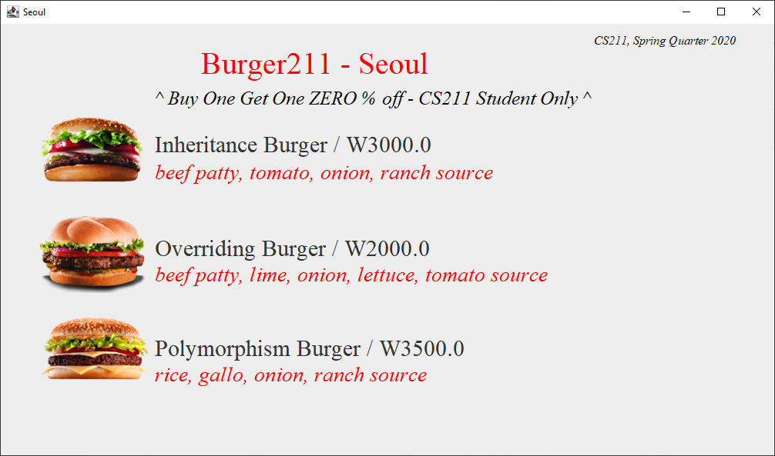
How to call GUI menu
new MenuGUI(franchise,info1,topping1,info2,topping2,info3,topping3,promo);

Slide 23
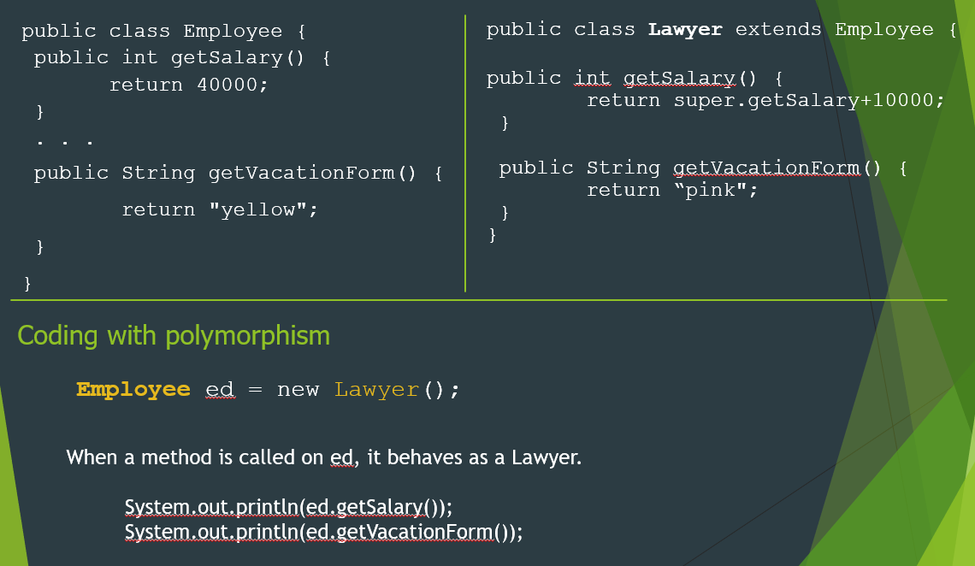
Main Program- myBurger211.java
package taesik;
public class myBurger211 {
public static void main(String[] args) {
Burger211 Bellevue = new USA();
Bellevue.Menu("Bellevue");
Burger211 Seattle = new USA();
Seattle.Menu("Seattle");
Burger211 PyeongChang = new KOREA();
PyeongChang.Menu("PyeongChang");
Burger211 Seoul = new KOREA();
Seoul.Menu("Seoul");
}
}
run-time Polymorphism
Slide # 28 (04-20-2020)

Slide 24
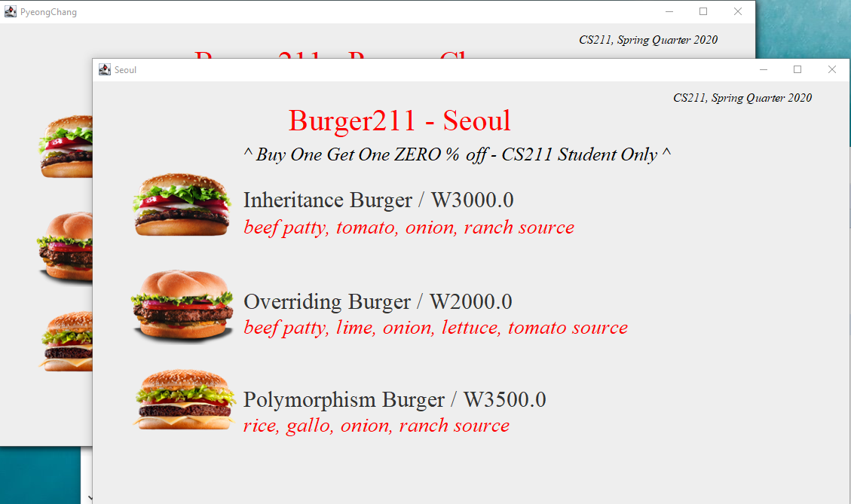
Output
Menus are all superimposed and the one behind them is not visible. Click here and then drag. You will see next one.

Slide 25
Next Step
Complete the program.
Super class: Burger211.java
Encapsulation: burger name, topping, and promotion
Initialization: burger name, topping, and promotion
Sub class: USA and one more country
Override: getToping1(), getToping2(), getToping3(), getAdvertising(), getName1(), getName2(), getName3()
Override Menu() in details if needed.
And more..

